Slide 1


Expense Management System
A user-friendly application to efficiently track, manage, and analyze personal expenses
Mentor
Junnuthula Rajesh Reddy

Slide 2
TEAM MEMBERS
NAME | CONTRIBUTION | EMAIL
Gokul S | Authentication, Users (Admin part) | gokulgss567@gmail.com
Chava Pardha Kalyan | Dashboard, Goal Setting | pardhakalyan2003@gmail.com
Arunabha Chatterjee | New Transaction, Transaction History | arunabha6289@gmail.com
Muskan Gupta | Saved Transactions, Statistics | muskang2898@gmail.com
Sakshi Jadhav | Transactions, Categories, New Category (Admin part) | sakshij1703@gmail.com

Slide 3
Agenda
Tools and Technologies
Database Design
User features
Admin features
Future Enhancements
Conclusion

Slide 4









Tools and Technologies
Backend (Spring Boot with JDK 17)
JDK 17 or above (LTS)
IntelliJ IDEA IDE
Spring Initializr
Database
MySQL 8.0.x
Frontend (React with npm)
Node.js 18.x LTS
Visual Studio Code 1.83.x
API Testing
Postman
Additional Tools
Git 2.42.x

Slide 5
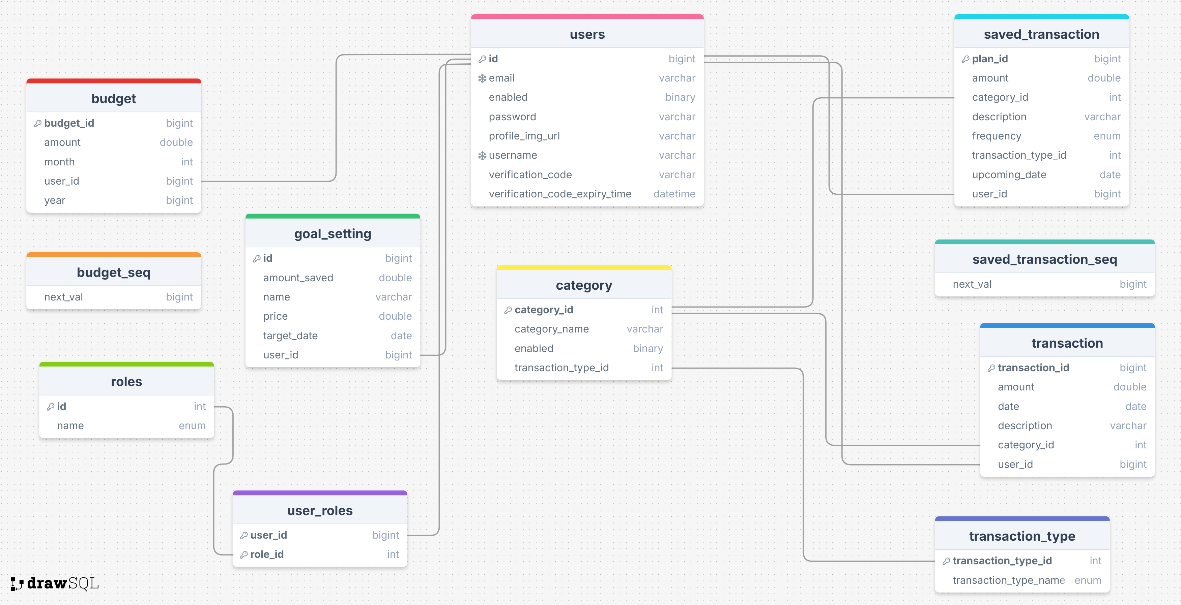
Database Design

Slide 6
User Features
Registration and Login
Dashboard
Transaction History
New Transaction
Saved Transactions
Goal Setting
Statistics
Settings

Slide 7
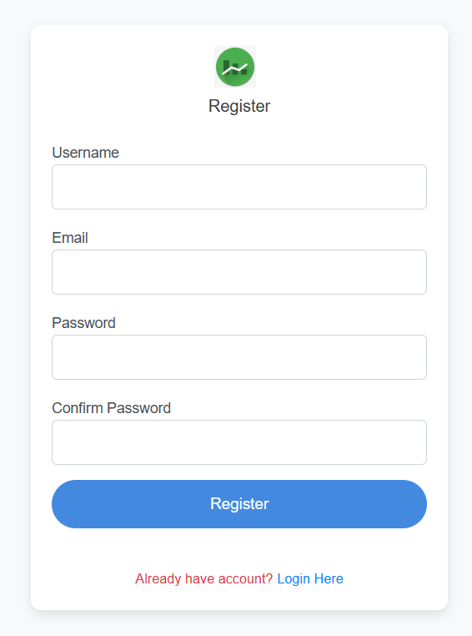
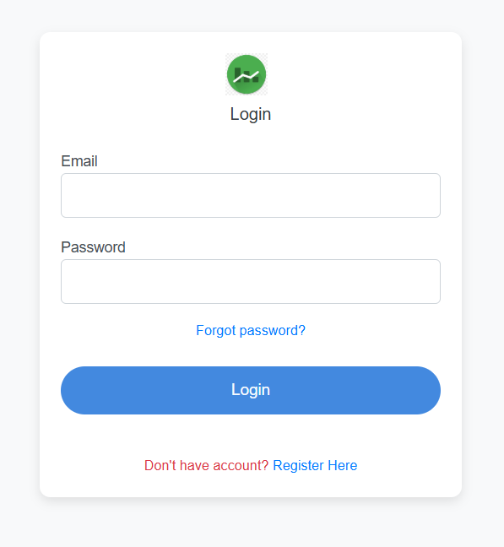
Registration and Login

Slide 8
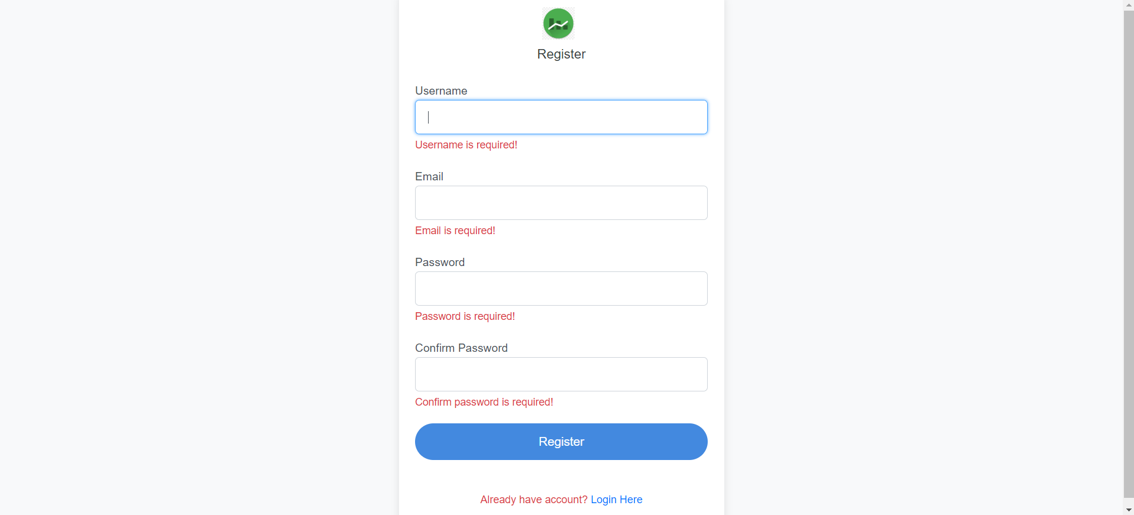
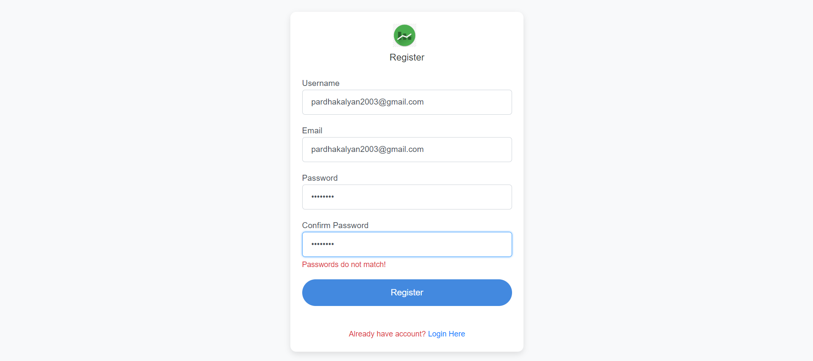
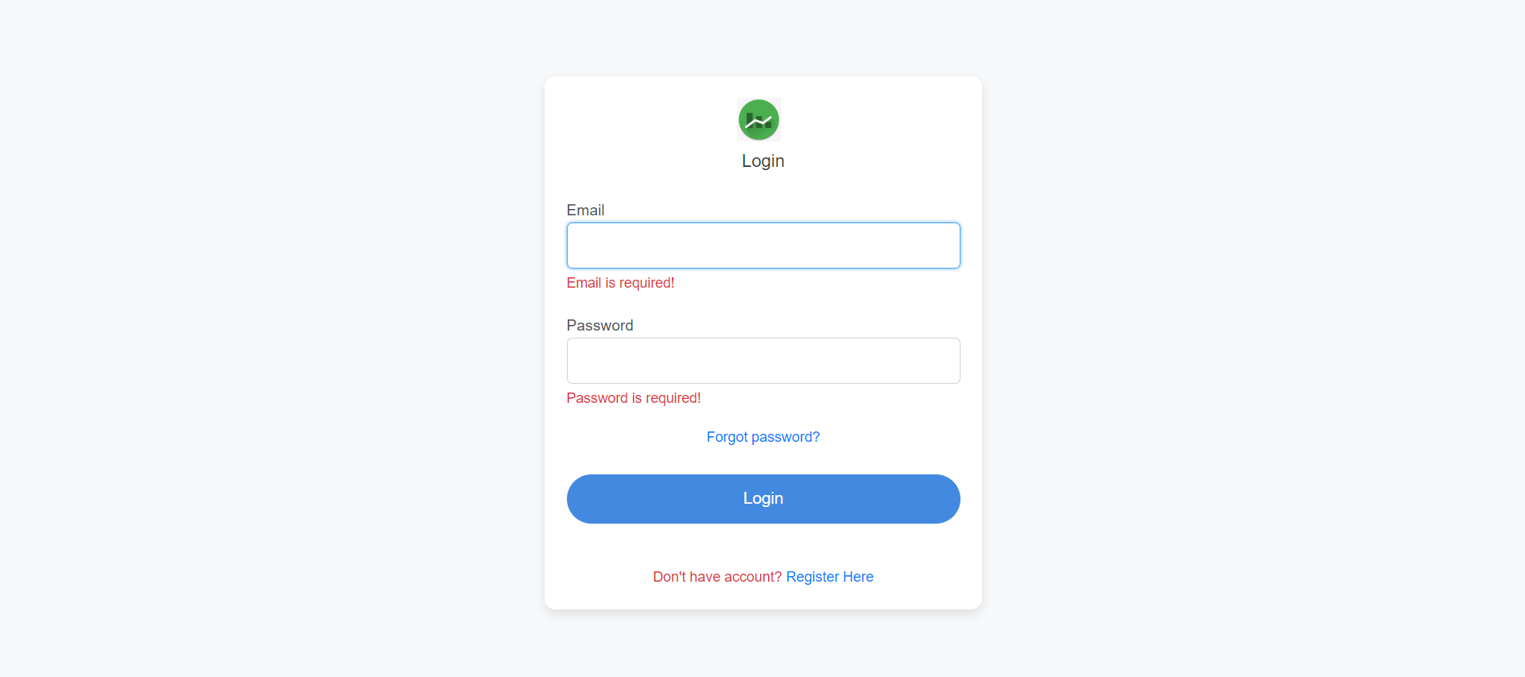
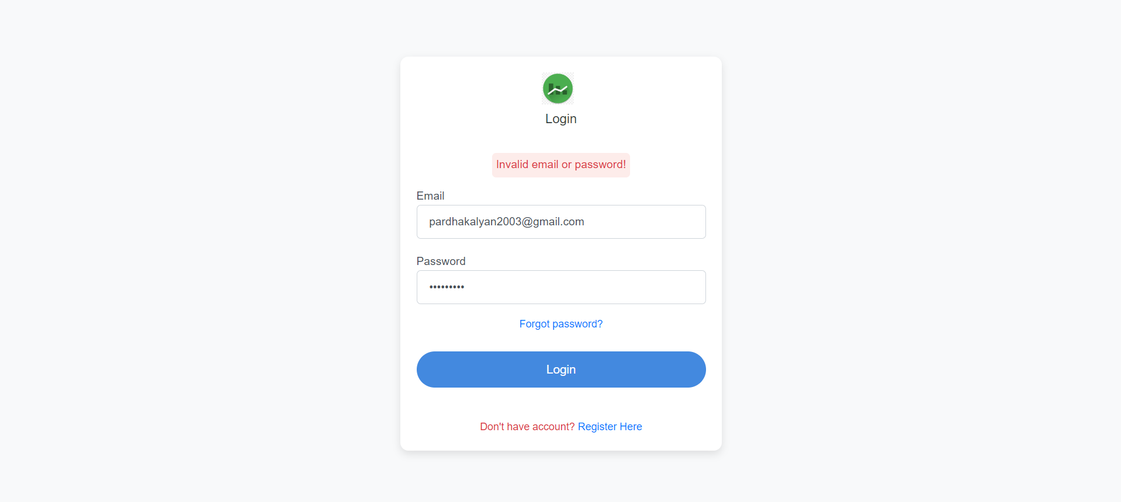
Error Handling

Slide 9
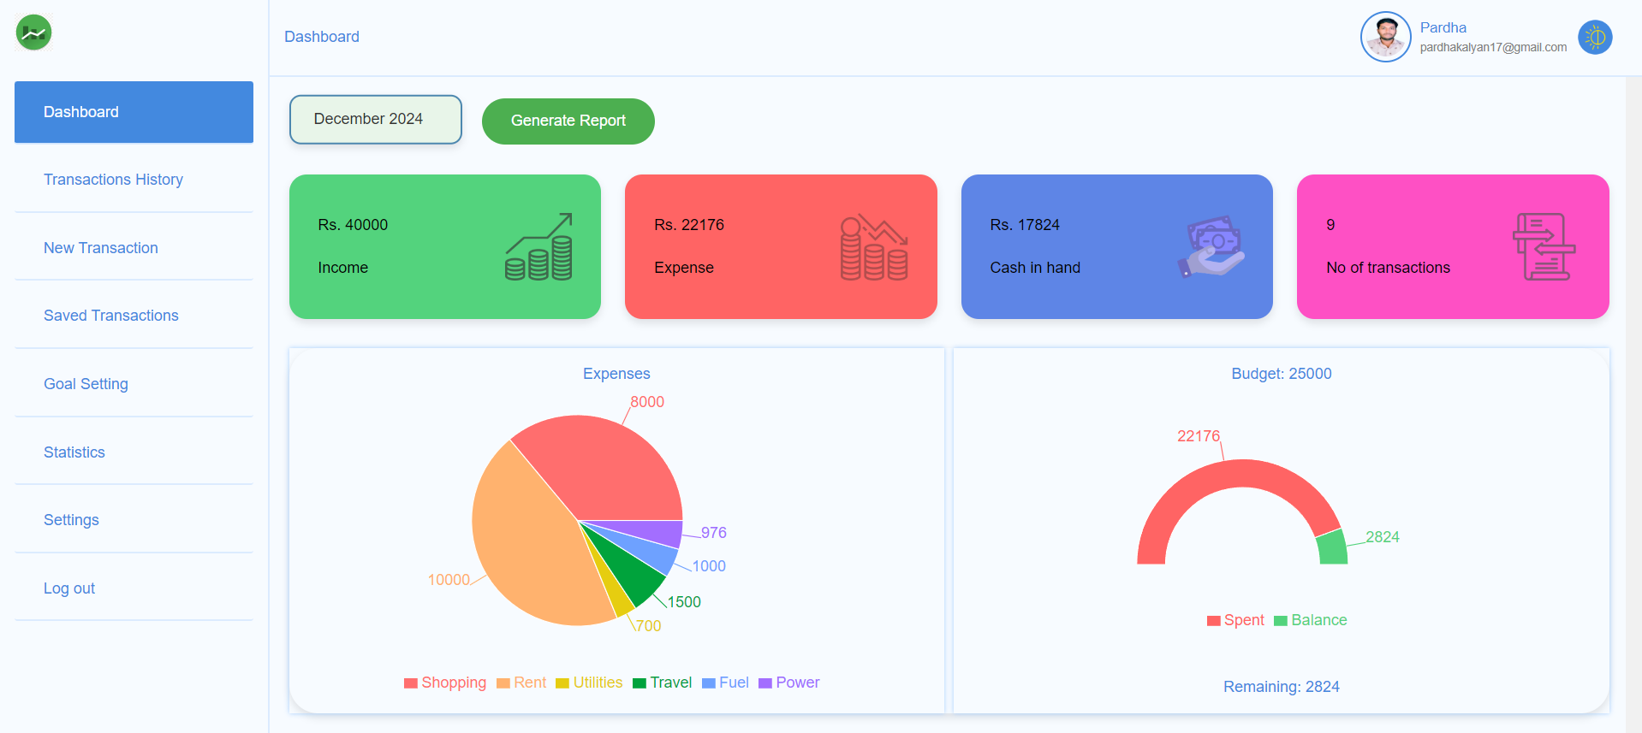
Dashboard

Slide 10
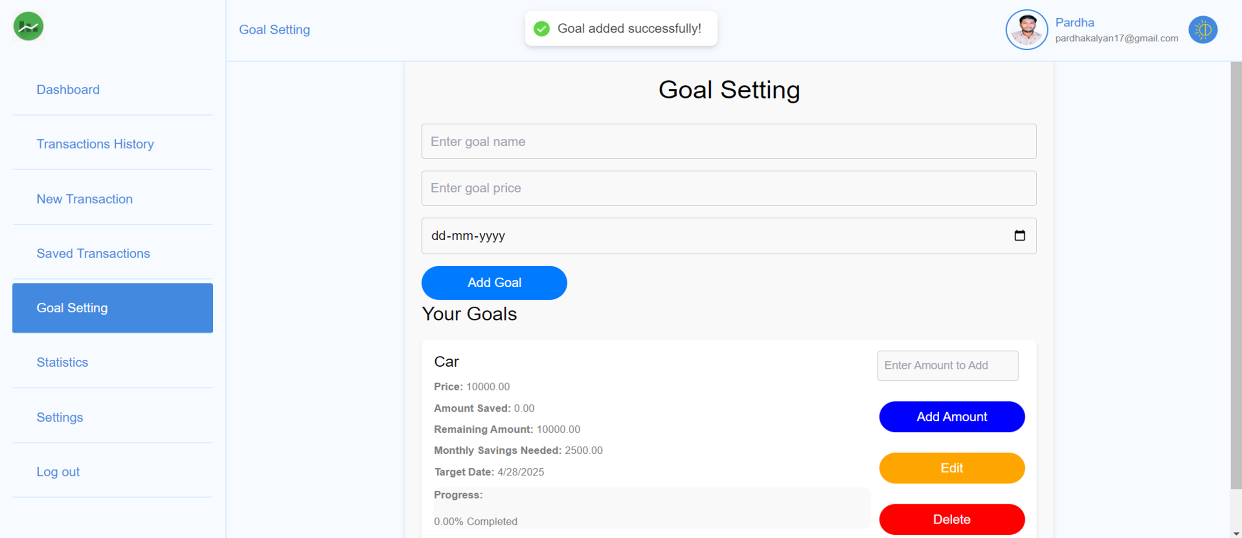
Goal Setting

Slide 11
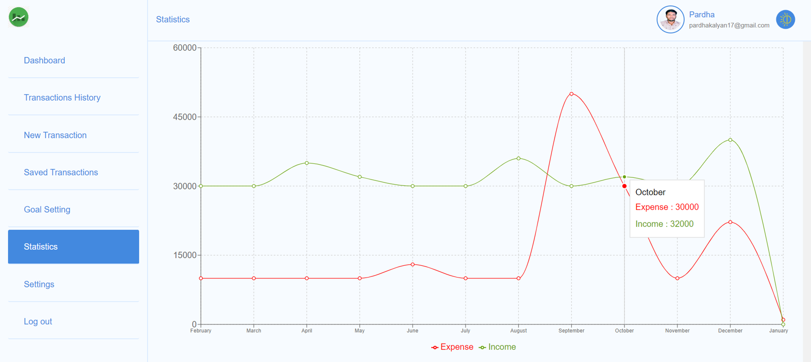
Statistics

Slide 12
Admin Features
Login and Registration
Transactions
Users
New Category
Categories
Settings

Slide 13
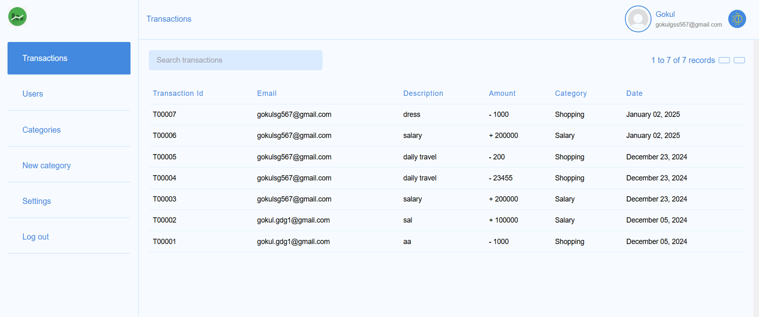
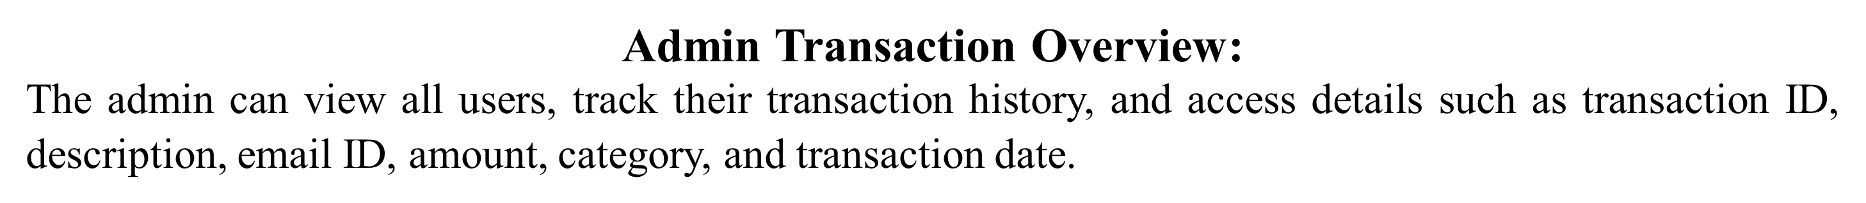
Transactions

Slide 14
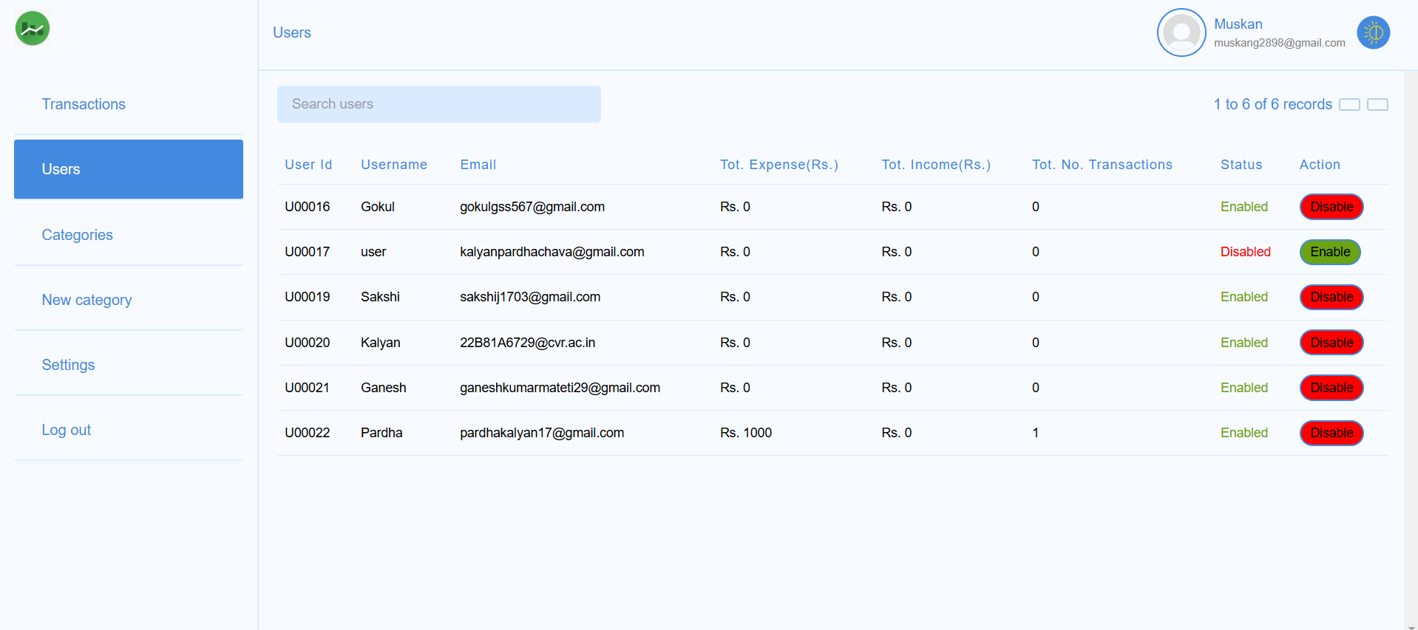

Users

Slide 15
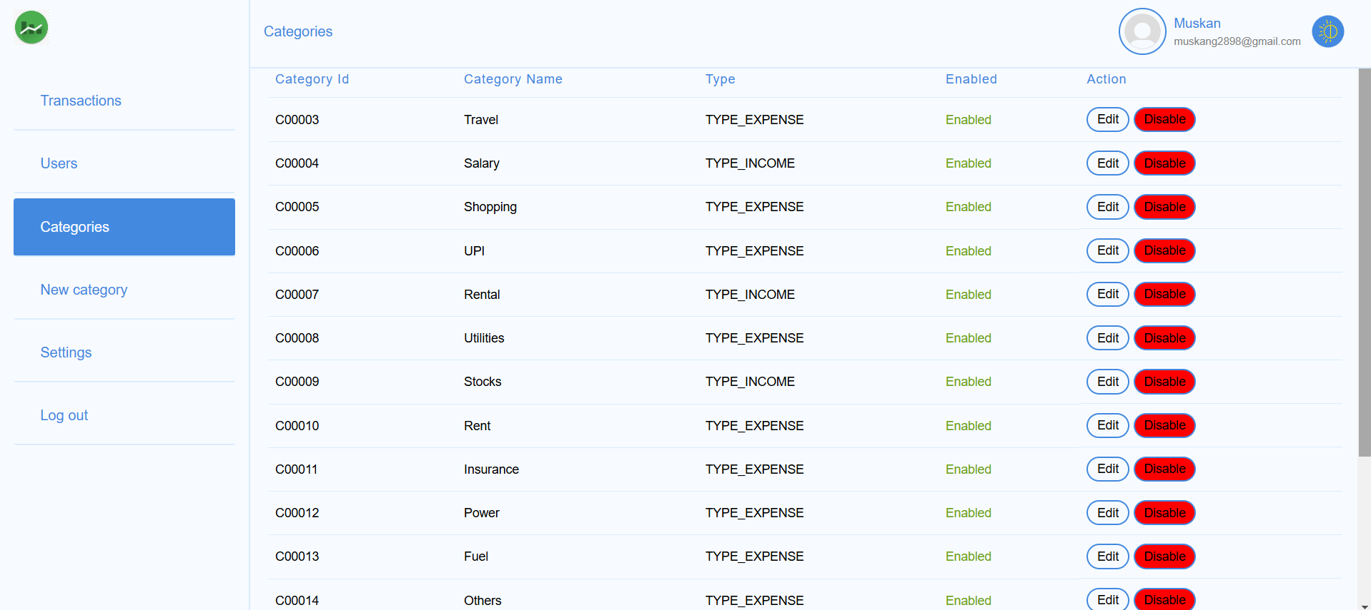
Categories

Slide 16
Future Enhancements
Multi language Support
Multi-Currency Support
Integration with External APIs
Voice Command Support
Mobile App

Slide 17
Conclusion
The Expense Management System is a user-friendly platform offering a wide range of functionalities to simplify personal finance management.
With its advanced features for both users and administrators, the system ensures a comprehensive approach to tracking and optimizing financial health.
By leveraging cutting-edge technologies like Spring Boot and React.js, the application guarantees performance, scalability, and a seamless user experience.

Slide 18


